Slide 1
Lead Scoring Case Study
To Build a Logistic Regression Model To predict whether a lead for online courses for an X education company would be successfully converted or not
By- 1. Pratibha Chougule
2. Bhagyashree Dhole

Slide 2
Problem Statement
X Education cells online courses to industry professionals
X Education gets a lot of leads, its lead conversion rate is very poor. For example, if, say, they acquire 100 leads in a day, only about 30 of them are converted.
To make this process more efficient, the company wishes to identify the most potential leads, also known as ‘Hot Leads’
If they successfully identify this set of leads, the lead conversion rate should go up as the sales team will now be focusing more on communicating with the potential leads rather than making calls to everyone.

Slide 3
• To help X Education to select the most promising leads(Hot Leads), i.e. the leads that are most likely to convert into paying customers.
• To build a logistic regression model to assign a lead score value between 0 and 100 to each of the leads which can be used by the company to target potential leads.
Business Objective

Slide 4
Solution Methodology
Data cleaning and data manipulation.
Check and handle duplicate data.
Check and handle NA values and missing values.
Drop columns, if it contains large amount of missing values and not useful for the analysis.
Imputation of the values, if necessary.
Check and handle outliers in data.
EDA
Univariate data analysis: value count, distribution of variable etc.
Bivariate data analysis: correlation coefficients and pattern between the variables etc.
Feature Scaling & Dummy Variables and encoding of the data.
Classification technique: logistic regression used for the model making and prediction.
Validation of the model.
Model presentation.
Conclusions and recommendations.

Slide 5
Data Manipulation
Total Number of Rows =37, Total Number of Columns =9240.
Single value features like “Magazine”, “Receive More Updates About Our Courses”, “Update me on Supply
Chain Content”, “Get updates on DM Content”, “I agree to pay the amount through cheque” etc. have been dropped
Removing the “Prospect ID” and “Lead Number” which is not necessary for the analysi
After checking for the value counts for some of the object type variables, we find some of the features which has no enough variance, which we have dropped, the features are: “Do Not Call”, “What matters most to you in choosing course”, “Search”, “Newspaper”
Article”, “X Education Forums”, “Newspaper”, “Digital Advertisement” etc.
Dropping the columns having more than 35% as missing value such as ‘How did you hear about X Education’ and ‘Lead Profile’.

Slide 6
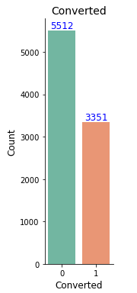
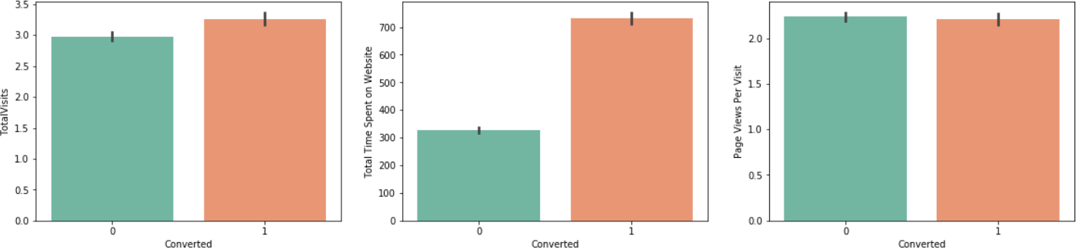
Exploratory Data Analysis
We have around 39% Conversion rate in Total
The conversion rates were high for Total Visits, Total Time Spent on Website and Page Views Per Visit
.

Slide 7
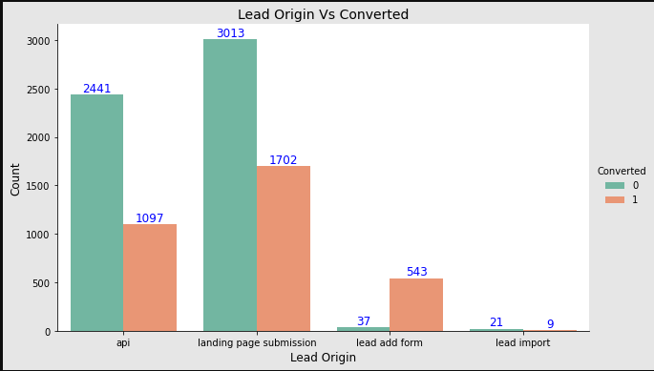
In Lead Origin, maximum conversion happened from Landing Page Submission

Slide 8
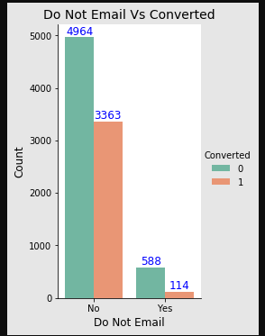
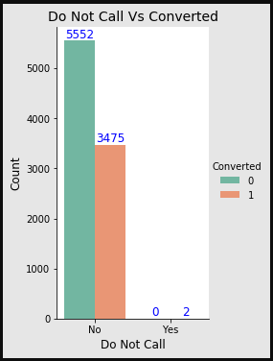
Major conversion has happened from Emails sent and Calls made

Slide 9
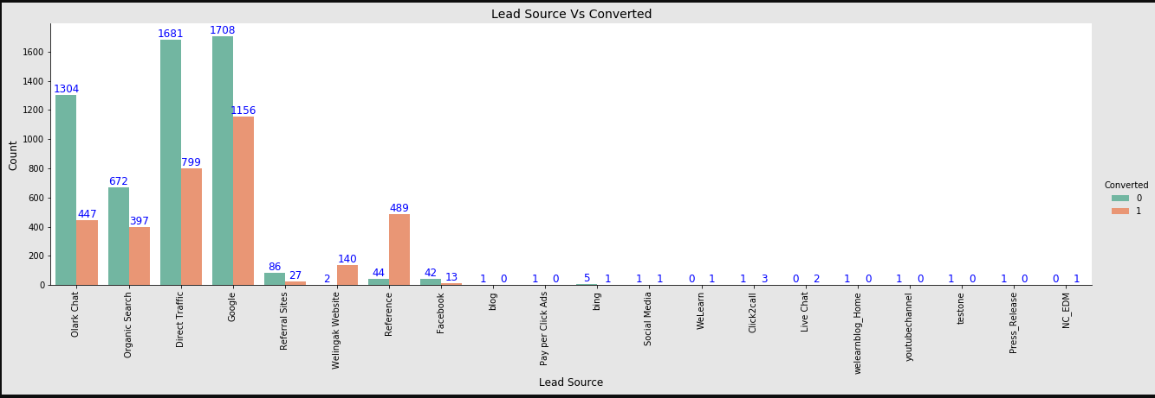
Major conversion in the lead source is from Google

Slide 10

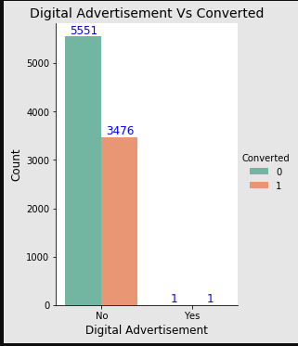
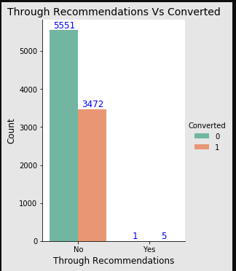
Not much impact on conversion rates through Search, digital advertisements and through recommendations

Slide 11
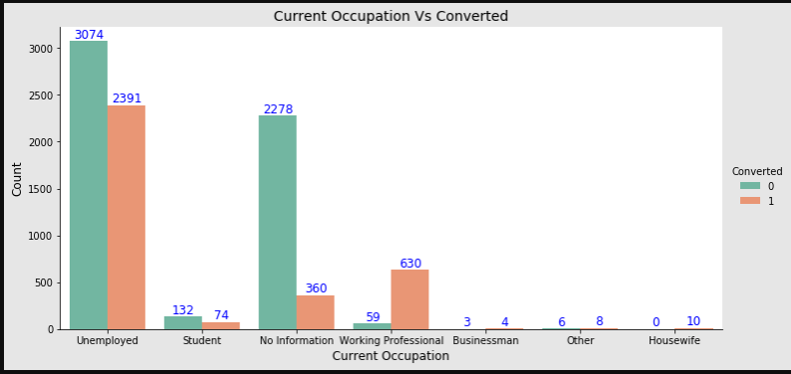
More conversion happened with people who are unemployed

Slide 12
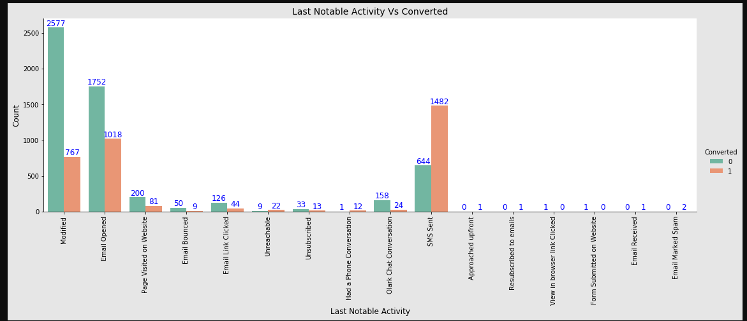
Last Activity value of SMS Sent' had more conversion

Slide 13
Variables Impacting the Conversion Rate
Total Time Spent On Website
Lead Origin – Lead Add Form
Last Source – Welingak Website
Do Not Email_yes
Last Activity_converted to lead
Last Activity – Email Bounced
What is your current occupation_housewife
What is your current occupation_student
What is your current occupation_unemployed
What is your current occupation_working professional
Last Notable Activity_email link clicked
Last Notable Activity_email opened
Last Notable Activity_modified
Last Notable Activity_olark chat conversation
Last Notable Activity_page visited on website

Slide 14
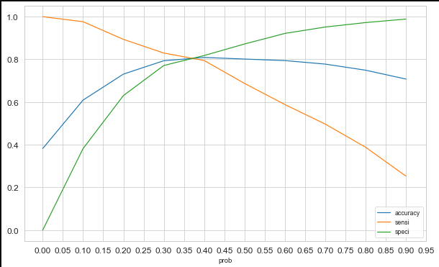
Model Evaluation - Sensitivity and Specificity on Train Data Set
The graph depicts an optimal cut off of 0.37 based on Accuracy, Sensitivity and Specificity
Confusion Matrix
3104
730
466
1904
Accuracy - 80%
Sensitivity - 80 %
Specificity - 81 %
False Positive Rate - 16 %
Positive Predictive Value - 74 %
Negative Predictive Value – 87%

Slide 15
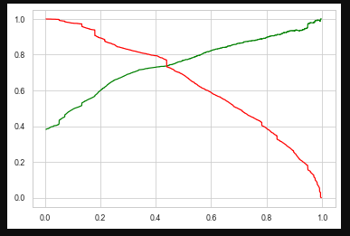
Model Evaluation – Precision and Recall on Train Data Set
The graph depicts an optimal cut off of 0.42 based on Precision and Recall
Confusion Matrix
3149
685
498
1827
Precision - 73%
Recall - 78 %

Slide 16
Model Evaluation – Sensitivity and Specificity on Test Dataset
Confusion Matrix
1410
268
207
774
Accuracy - 81 %
Sensitivity - 82 %
Specificity - 81 %

Slide 17
Conclusion
While we have checked both Sensitivity-Specificity as well as Precision and Recall Metrics, we have considered the optimal cut off based on Sensitivity and Specificity for calculating the final prediction. –
Accuracy, Sensitivity and Specificity values of test set are around 81%, 82% and 81% which are approximately closer to the respective values calculated using trained set.
Also the lead score calculated shows the conversion rate on the final predicted model is around 79% (in train set) and 78% in test set
The top 3 variables that contribute for lead getting converted in the model are
Total Time Spent on Website
Lead Add Form (from Lead Origin)
What is your current occupation_working professional
Hence overall this model seems to be good.

